Slide 1
Gamifying Facial Emotion Recognition for Both Human Training and Machine Learning Data Collection
Yeonsun Yang¹
Ahyeon Shin¹
Nayoung Kim¹
Huidam Woo¹
John Joon Young Chung²
Jean Y. Song¹
1
2
Midjourney
Notes:
In this presentation, I will introduce our web-based game called 'Find the Bot,' alongside our paper. My name is Yeonsun Yang, and this work was completed with great collaborators from DGIST in South Korea and Midjourney.

Slide 2
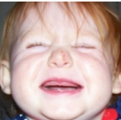
Motivation
Facial Emotion Recognition In the Real-world
😀
Happy
😭
Sad
An example of in-the-wild FER datasets
Spontaneous facial expressions are diverse, subjective, and ambiguous.
Notes:
This is one of the real controversial examples of the FER dataset. What do you think this expression looks like? Happy? or Sad? The facial expressions we encounter in the wild are diverse, subjective, and ambiguous, making them difficult to judge. So, it's challenging for both humans and machines.

Slide 3
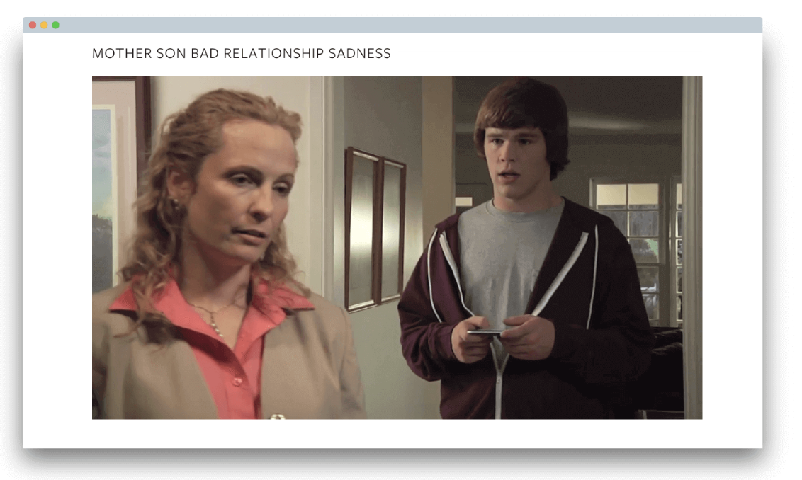
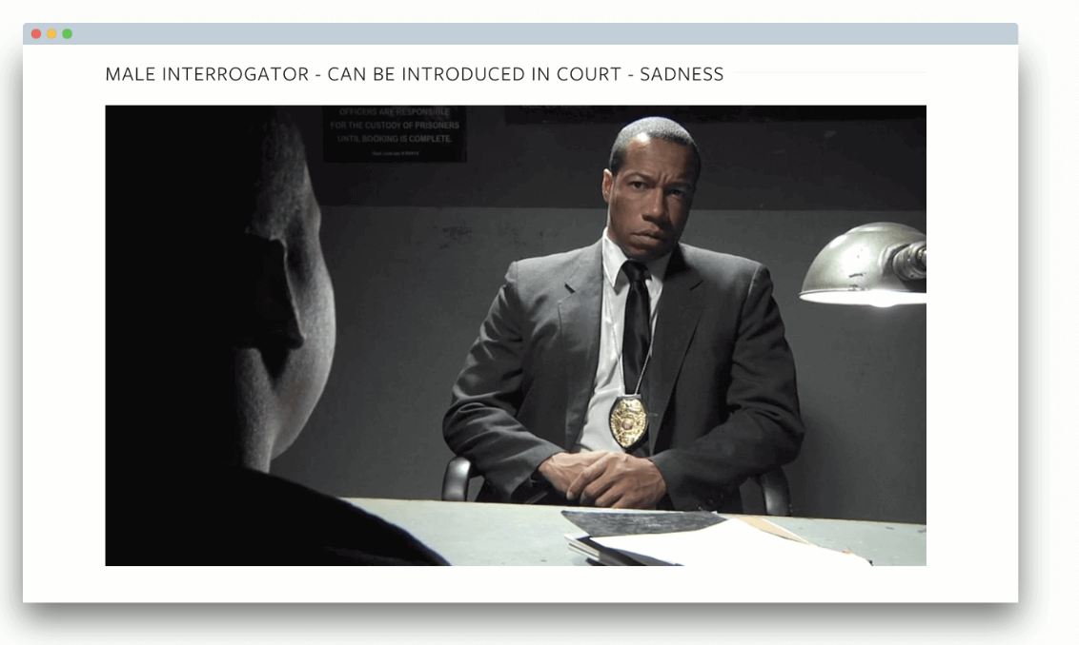
Motivation
The Impact of FER on Interactions
FER is important for both human-human interactions and human-machine interactions.
# Family
# Workplace
# Law Enforcement
Notes:
According to extensive previous research, Facial Emotion Recognition, commonly known as FER, is a crucial aspect of both human-human and human-machine interactions in our daily social lives. So, researchers in the fields of psychology, neuroscience, and computer vision have made significant efforts to improve their FER abilities.

Slide 4
Motivation
Who Needs FER Training?
Clinical Populations
Professionals
General Populations
Notes:
Traditionally, psychologists have conducted FER training targeting specific groups, such as clinical populations or professionals
However, currently, as the importance of FER gains emphasis in interpersonal relationships and collaboration, the target group has expanded to non-clinical general populations.
-----
, with autism or Asperger syndrome, or professionals who need special training on reading micro expressions.

Slide 5
Related Work
Training Interfaces to Enhance Human FER
Emotion
Feedback
Happy
The inner corners of the eyebrows and angled downward
Sad
Disgust
Neutral
Image 1/20
NEXT
Learner
Micro Expressions Training Tool (METT)
Ekman et al., 2003
Notes:
So, to provide scalable and flexible training, psychologists have introduced computer-based FER training tool. For example, learners practice making emotional assumptions by viewing facial expression images on the screen, clicking on a correct emotion label button on left side, and receiving feedback such as ‘well done’ or ‘try again’.
The effectiveness of these interfaces has been proven, but there are significant limitations.

Slide 6
Related Work
Training Interfaces to Enhance Human FER
Facial expression images taken in controlled environments with action units
Limitations
Emotion
Feedback
Happy
The inner corners of the eyebrows and angled downward
Limited to sign-based training
Limited to self-administered training
Tedious and repetitive sessions
Sad
Disgust
Neutral
Image 1/20
NEXT
Sign-based explanation of emotion with action units
Micro Expressions Training Tool (METT)
Ekman et al., 2003
Notes:
First, its sign-based training makes it hard to capture the diversity and ambiguity of facial expressions found in the real world.
And the self-administered training is less effective rather than group learning.
Finally, this simple task design demotivates learners from consistent and effective training.
----
where facial expressions are divided into small action units

Slide 7
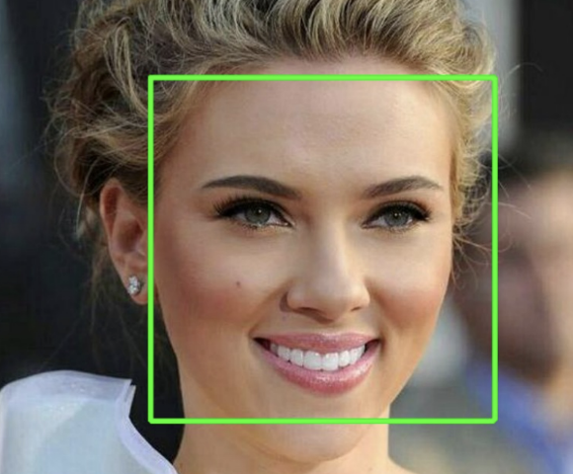
Related Work
Labeling Interfaces to Enhance Machine FER
Emotion
“Judgement-based approach”
Happy
Sad
Interprets facial expression based on how it is universally and heuristically perceived by a large common population
NEXT
Disgust
Neutral
Image 1/20
AffectNet: A Database for Facial Expression, Valence, and Arousal Computing in the Wild
Mollahosseini et al., IEEE Transactions on Affective Computing (2017)
Notes:
Interestingly, we have found that the interface design for collecting data to train machine FER is very similar to that used for training humans.
The difference lies in the judgment-based approach, which allows for the labeling of in the wild facial expression images.

Slide 8
Related Work
Labeling Interfaces to Enhance Machine FER
Limitations
Emotion
Happy
Large labeling error and bias
Limited to single-choice format
Tedious and repetitive sessions
Sad
NEXT
Disgust
Neutral
Image 1/20
AffectNet: A Database for Facial Expression, Valence, and Arousal Computing in the Wild
Mollahosseini et al., IEEE Transactions on Affective Computing (2017)
Notes:
However, there are large labeling error and bias, this is because the images are typically annotated by only one or two annotators
Additionally, single-choice interface design preclude secondary or subtle emotions.
And likewise, these simple task design demotivates annotators, resulting in careless and poor label quality.

Slide 9
Approach
Research Goal: Building an Integrated Interface
FER Training
Data Collection
Simultaneously addressing limitations
Notes:
This led us to ask, 'Could we solve two similar FER problems within a single interface?' This is our motivation.

Slide 10
Approach
Research Goal: Building an Integrated Interface
To effectively address the challenges identified in current interfaces within a single application,
# of Responses
Emotion Categories
(1) Engaging and motivating groups of general populations
(2) Group learning through interaction with each other
(3) Aggregating all socially-agreed emotional judgments collected from user groups
Notes:
To this end, we designed specific workflow like this. Engaging and motivating groups of general populations, and inducing group learning through interaction with each other. Finally, aggregating all socially agreed emotional judgments collected from user groups.

Slide 11
Approach
Research Goal: Building an Integrated Interface
# of Responses
Emotion Categories
”Gamification”
Notes:
However, this frequent interactions can be too burdensome for users and also very costly. So, to integrate this workflow voluntarily and without burden, we have gamified the process.

Slide 12
Approach
Design Probing
Based on iterative design probes (N=9):
[DG1]
[DG2]
[DG3]
Enable diverse layers of interactions to support learning socially agreed-upon interpretations of emotions
→ Observational learning, real-time personalized feedback, and reflection
Minimize the difficulty and effort required for the labeling actions during the game
→ Breaking labeling actions into smaller unit of work (i.e., binary labeling)
Provide game rules and elements that are easy to learn
→ Using mainstream game plot
Notes:
To this end, we set three specific design goals by reflecting feedback from three rounds of prototyping.
For each design goal, we designed the game to engage players in observing, providing feedback, and reflecting with each other.
,broke complex labeling actions into binary labeling, and used mainstream game plot.

Slide 13
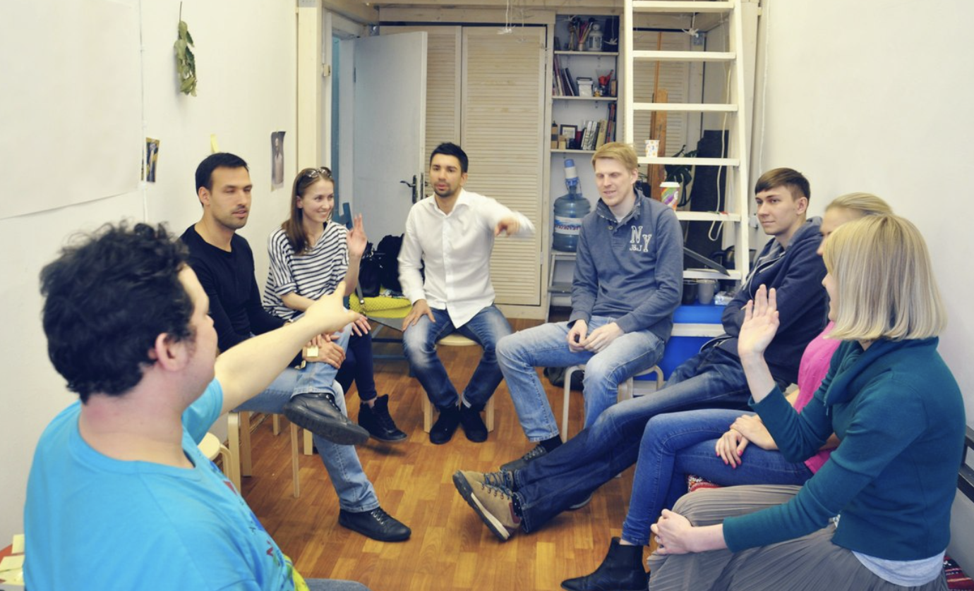
Approach
Design Probing
“Mafia Game Plot”
Active interactions among users, such as observation, debating, and voting
Useful for redesigning to incorporate suggestions and guidelines from literature
Requiring little time to adapt to the system due to its familiar rules
Notes:
Thus, after design probing, we decided to build the game using a popular mainstream game plot, the game of mafia. This choice was appropriate as it aligned with our design goals, which include promoting active interactions within user groups, facilitating the incorporation of various approaches, and employing familiar rules to reduce the adaptation time for this complex integrated system.

Slide 14
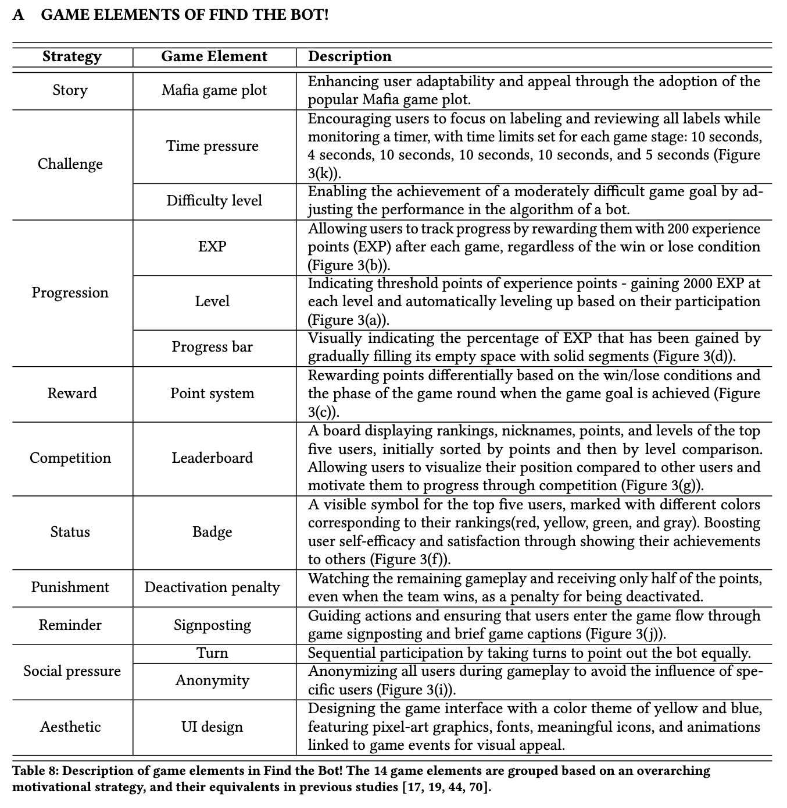
Approach
Find the Bot! : Strategies
Find the Bot! seamlessly incorporate a wide range of suggestions and guidelines from gamification, education, and crowdsourcing to motivate players using a combination of game elements.
Notes:
With three design goals in mind, we build the web-based game, Find the Bot!, which seamlessly incorporates a wide range of suggestions and guidelines from numerous literatures using design elements to motivate players. More details of each strategy can be found in the paper.

Slide 15
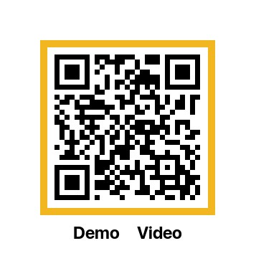
Approach
Find the Bot! : Gameplay
Round 1
HAPPY
Player1
Player5
Player2
Player4
Player3
Notes:
Here’s the overview of gameplay. Find the Bot! involves four human players who are anonymized in the game, along with an AI bot pretending to be a human.
The game goal is collaboratively finding the bot among players.

Slide 16
Approach
Find the Bot! : Gameplay
Round 1
HAPPY
Player1
Player5
Player2
Player4
Player3
16
Notes:
If two human players are deactivated or fail to find the bot, they lose.

Slide 17
Approach
Find the Bot! : Gameplay
Round 1
HAPPY
Player1
Player5
Player2
Player4
Player3
17
Notes:
Otherwise, they can win the game.

Slide 18
Approach
Find the Bot! : Gameplay
Round 1
HAPPY
Player1
Player5
Player2
Player4
Player3
18
Notes:
The game consists of four rounds, each featuring a randomly chosen emotion keyword from basic emotions. In each round, six game stages unfold.

Slide 19
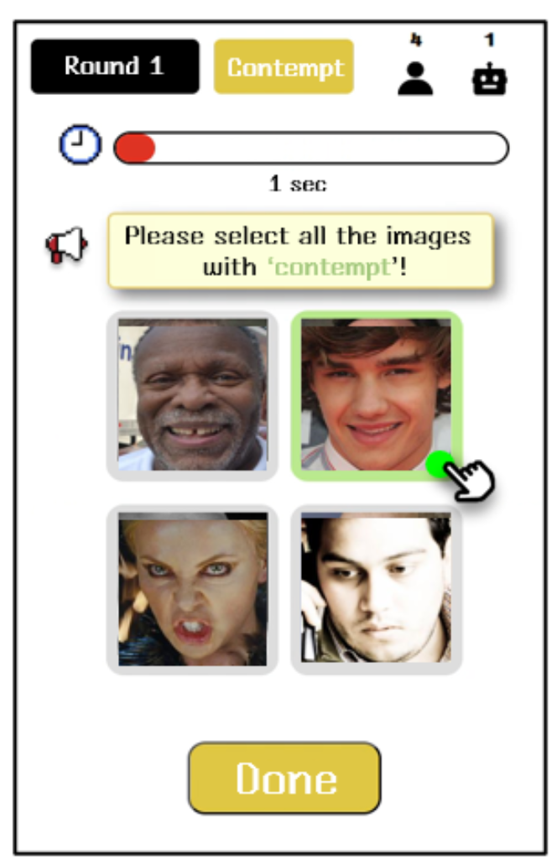
Approach
Find the Bot! : Gameplay
Game stages
Labeling
Skimming
Pointing out
Voting
Last defense
Advice
Notes:
In the labeling stage, each player is assigned facial expression images and has to click all the images that looks like emotion keyword.

Slide 20
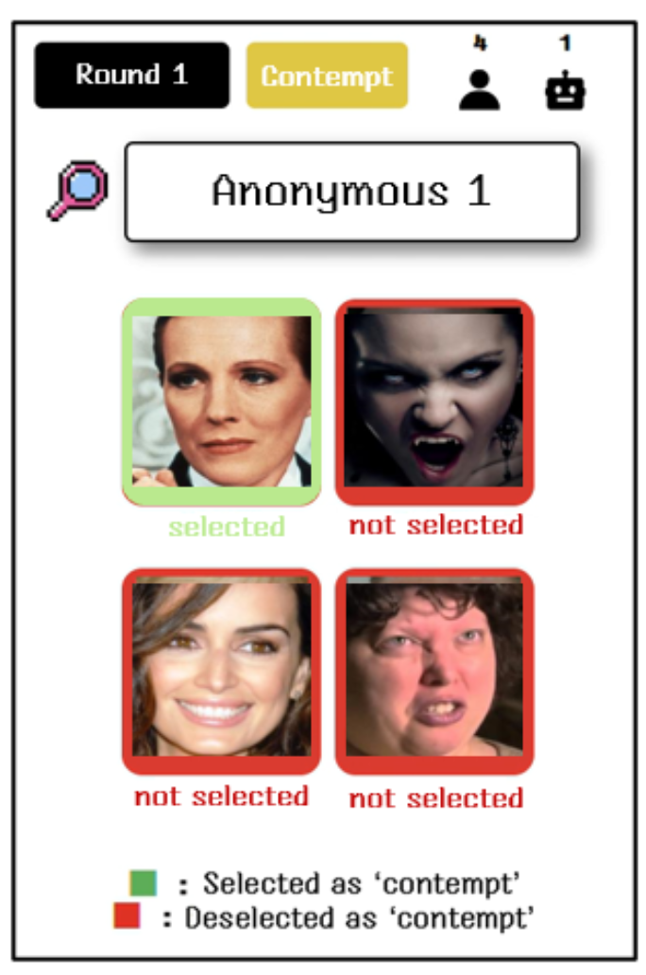
Approach
Find the Bot! : Gameplay
Game stages
Labeling
Skimming
Pointing out
Voting
Last defense
Advice
Notes:
After the labeling stage, players can quickly review the other players' image-labeling sets.

Slide 21
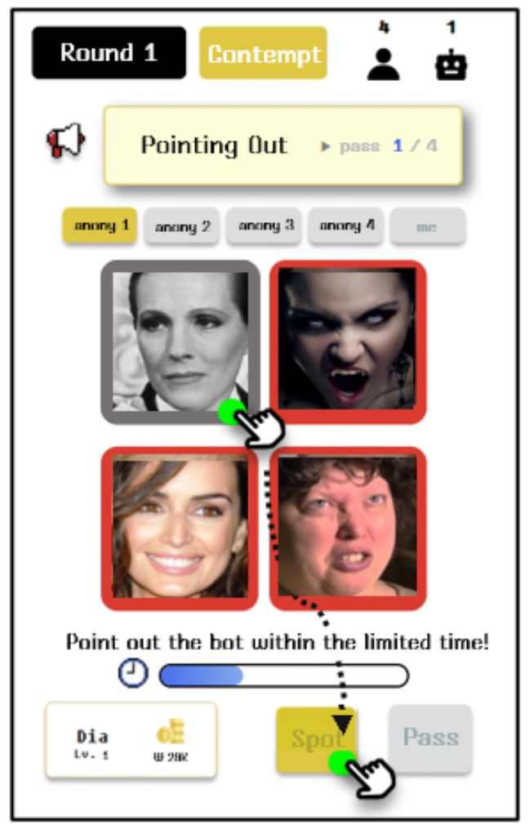
Approach
Find the Bot! : Gameplay
Game stages
Labeling
Skimming
Pointing out
Voting
Last defense
Advice
Notes:
In the pointing out stage, every players takes turns to point out a player they believe might be the bot due to suspicious labeling.

Slide 22
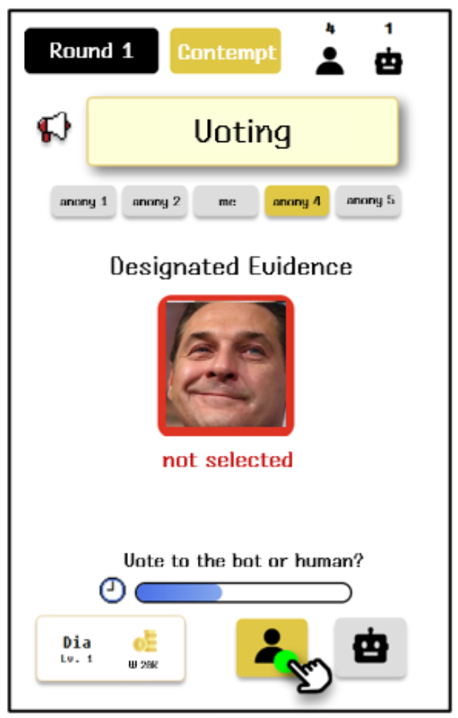
Approach
Find the Bot! : Gameplay
Game stages
Labeling
Skimming
Pointing out
Voting
Last defense
Advice
Notes:
If someone was pointed out, all players vote to conclude whether he is really a bot or not. If the majority agree with the suspicion, the pointed player enters the last defense stage.

Slide 23
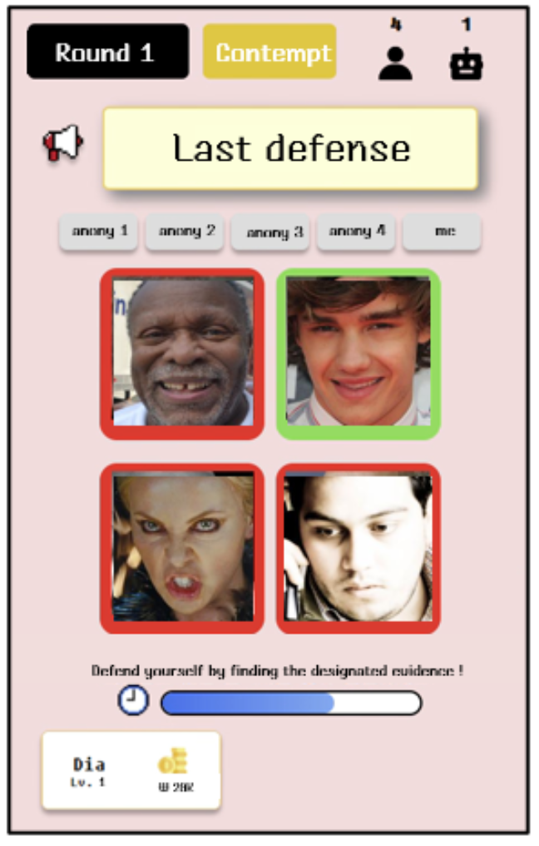
Approach
Find the Bot! : Gameplay
Game stages
Labeling
Skimming
Pointing out
Voting
Last defense
Advice
Notes:
During this stage, the pointed player has to identify the labeled image that may appear unconvincing to the other players.
If the player fails to find it, he will be deactivated from the game.

Slide 24
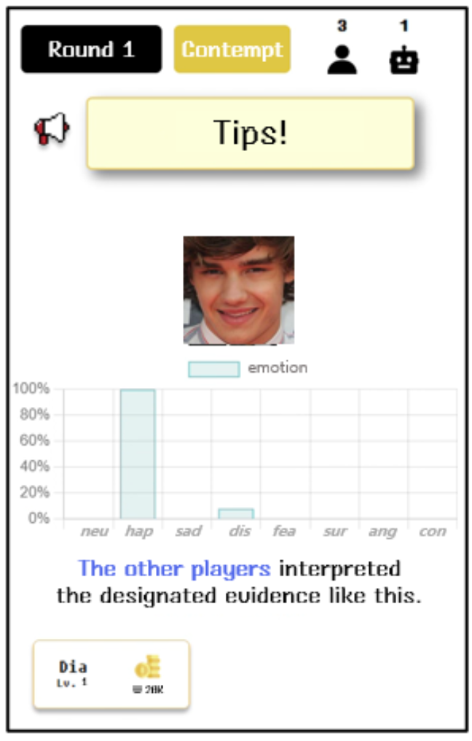
Approach
Find the Bot! : Gameplay
Game stages
Labeling
Skimming
Pointing out
Voting
Last defense
Advice
Notes:
To help understand the image with controversial labels, during the advice stage, all players can view a graph showing the distribution of labels.

Slide 25
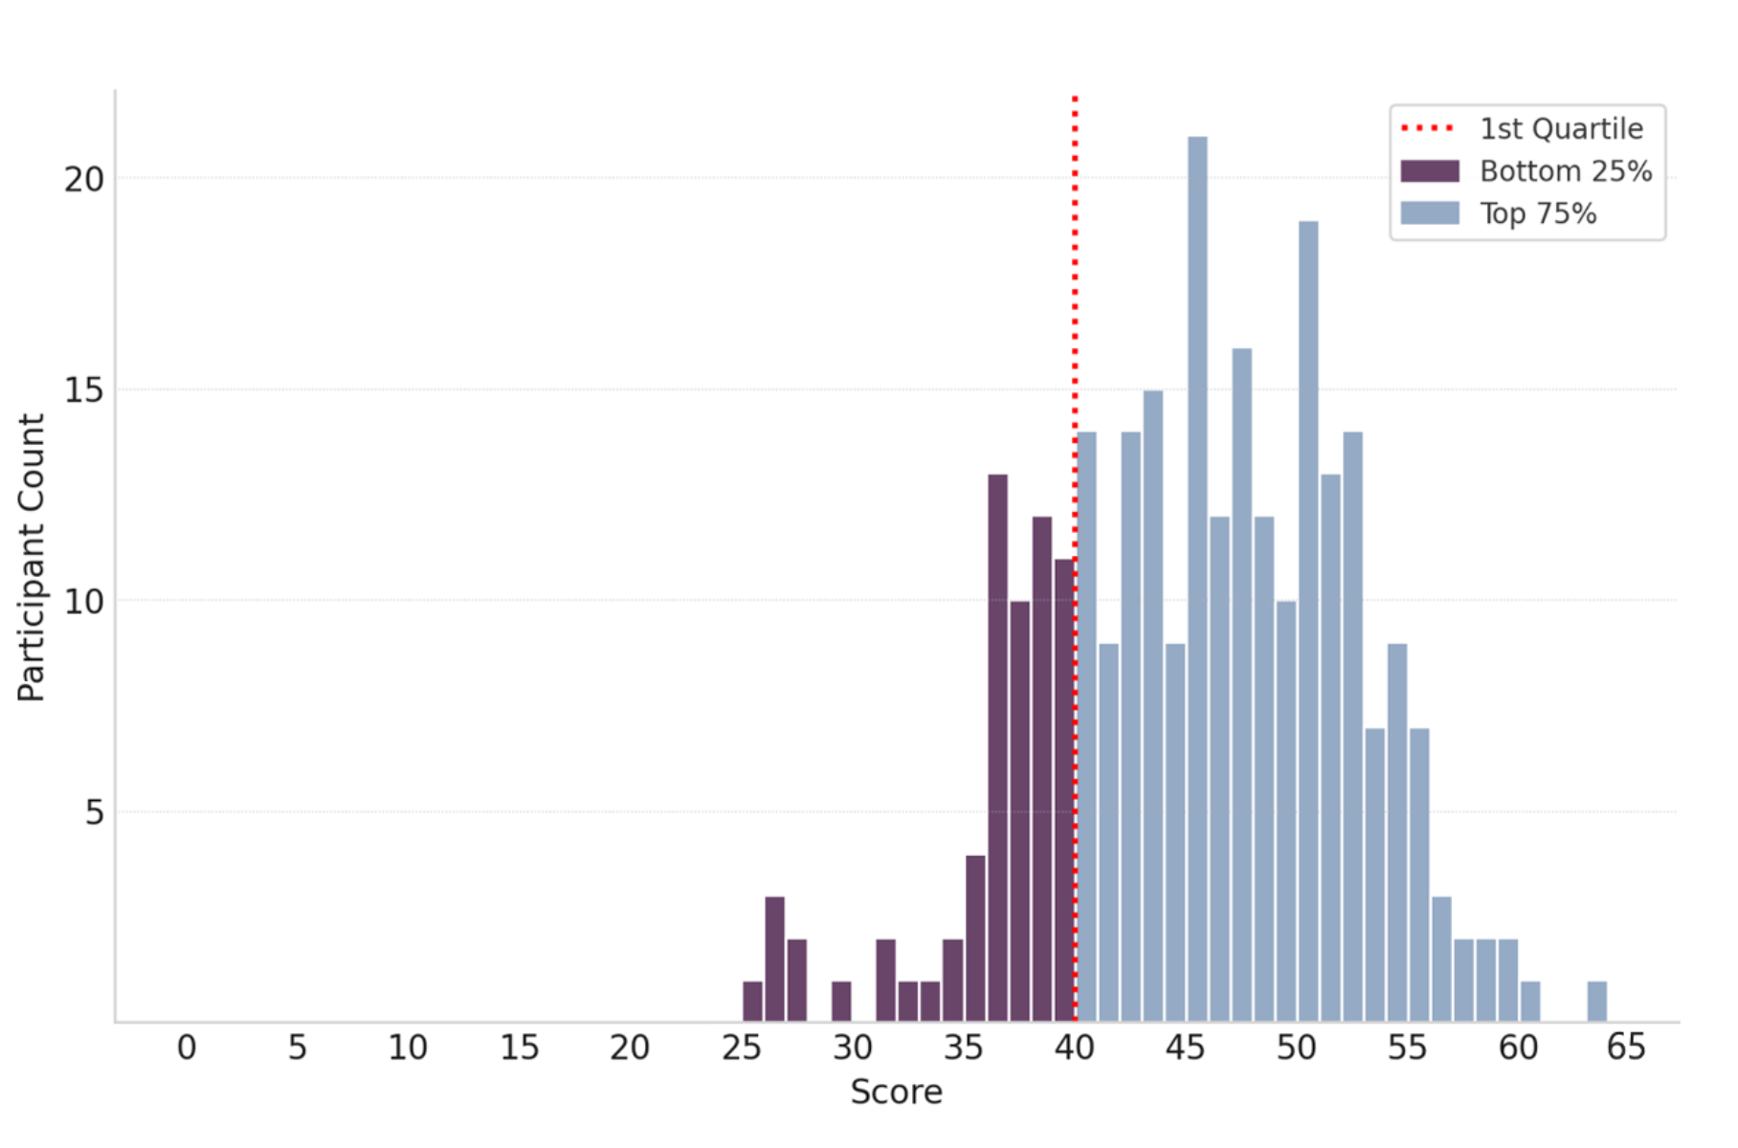
Experiment
Evaluation Setup
Ground-truth measures* (N=275)
Assessing FER scores (0~64 points)
Criteria to divide participants into low FER group or not (40 points)
Providing a basis for judgment-based scoring
User study (N=59)
Classifying 22 participants as low FER group and 37 as ordinary group based on their pre-survey FER scores
Randomly dividing the low FER group into learner group (n=11) and control group (n=11)
*Japanese and Caucasian Facial Expressions of Emotion (JACFEE) and Neutral Faces (JACNeuF)
Matsumoto et al., (1988)
Notes:
Before conducting user study, we collected ground truth measures from 275 people by online survey. For this, we utilized one of the most widely used measures of FER, scoring on a scale from 0 to 64.

Slide 26
Experiment
Evaluation Setup
Ground-truth measures* (N=275)
Assessing FER scores (0~64 points)
Criteria to divide participants into low FER group or not (40 points)
Providing a basis for judgment-based scoring
User study (N=59)
Classifying 22 participants as low FER group and 37 as ordinary group based on their pre-survey FER scores
Randomly dividing the low FER group into learner group (n=11) and control group (n=11)
*Japanese and Caucasian Facial Expressions of Emotion (JACFEE) and Neutral Faces (JACNeuF)
Matsumoto et al., (1988)
Notes:
To evaluate the feasibility of Find the Bot, we conducted a user study with 59 participants. Based on the first quartile score of 40 on ground-truth measures, we classified 22 participants into the low FER group and then randomly divided them into learner and control groups.

Slide 27
Experiment
Evaluation Setup
Playing Find the Bot!
Plain labeling task
Learner group
(N=11)
Player group
(N=37)
Control group
(N=11)
Two 90-mins lab sessions
A 90-mins lab session
pre-test to evaluate their FER scores
Playing Find the Bot! with pre-matched team consisting of one learner and three players
Post-test to assess improvements in their FER scores
Survey on user experience (GEQ, SUS, customized questions)
pre-test to evaluate their FER scores
Labeling 200 in-the-wild facial expression images
Post-test to assess improvements in their FER scores
Notes:
The study consisted of two different tasks. Both the learner and ordinary player groups were assigned a task for playing Find the Bot. In these sessions, participants take a pre-test and play our game.
Afterwards, they take a post-test and complete a survey on user experience.

Slide 28
Experiment
Evaluation Setup
Playing Find the Bot!
Plain labeling task
Learner group
(N=11)
Player group
(N=37)
Control group
(N=11)
Two 90-mins lab sessions
A 90-mins lab session
pre-test to evaluate their FER scores
Playing Find the Bot! with pre-matched team consisting of one learner and three players
Post-test to assess improvements in their FER scores
Survey on user experience (GEQ, SUS, customized questions)
pre-test to evaluate their FER scores
Labeling 200 in-the-wild facial expression images
Post-test to assess improvements in their FER scores
Notes:
To compare the effectiveness of our game with current limited interface design, a control experiment was conducted. The control group was assigned a plain labeling task for 200 facial expression images.
During the session, participants take a pre- and post-test to evaluate improvements in FER scores.
--------------
To provide a consistent experience with the learner group, we used the same set of images as those used in the game. Afterwards, the control group take a post-test to evaluate improvements in their FER scores.

Slide 29
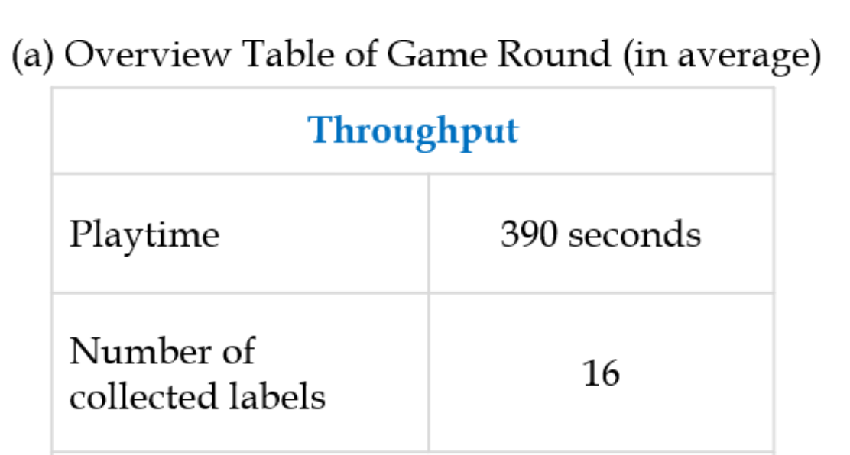
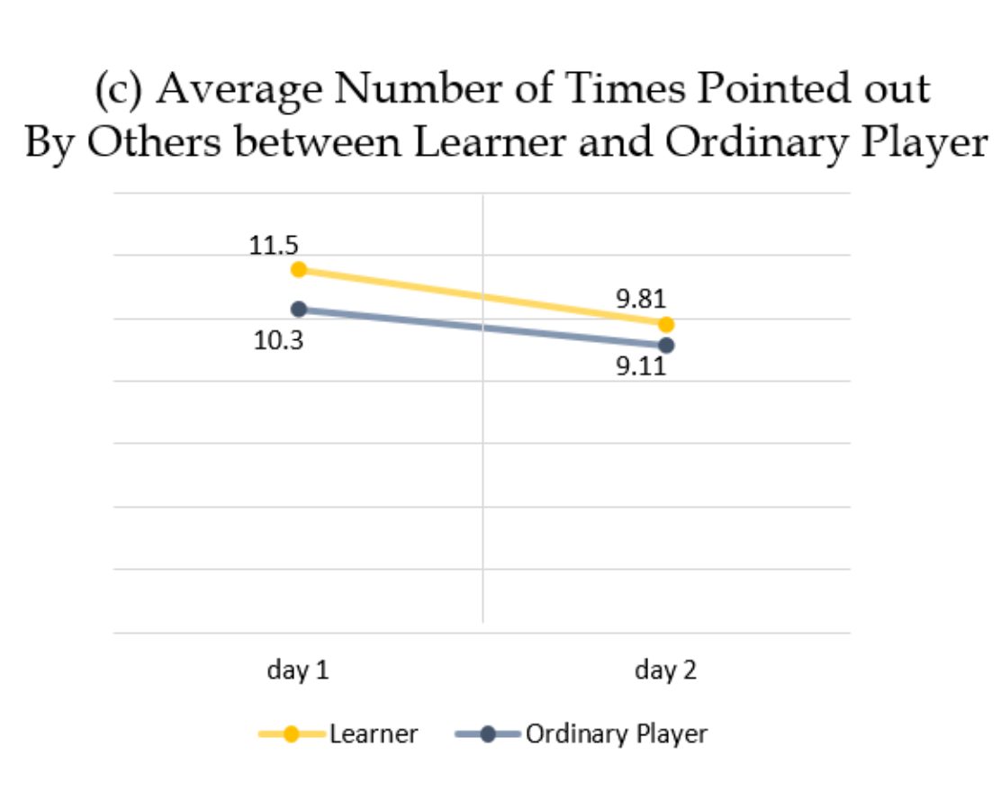
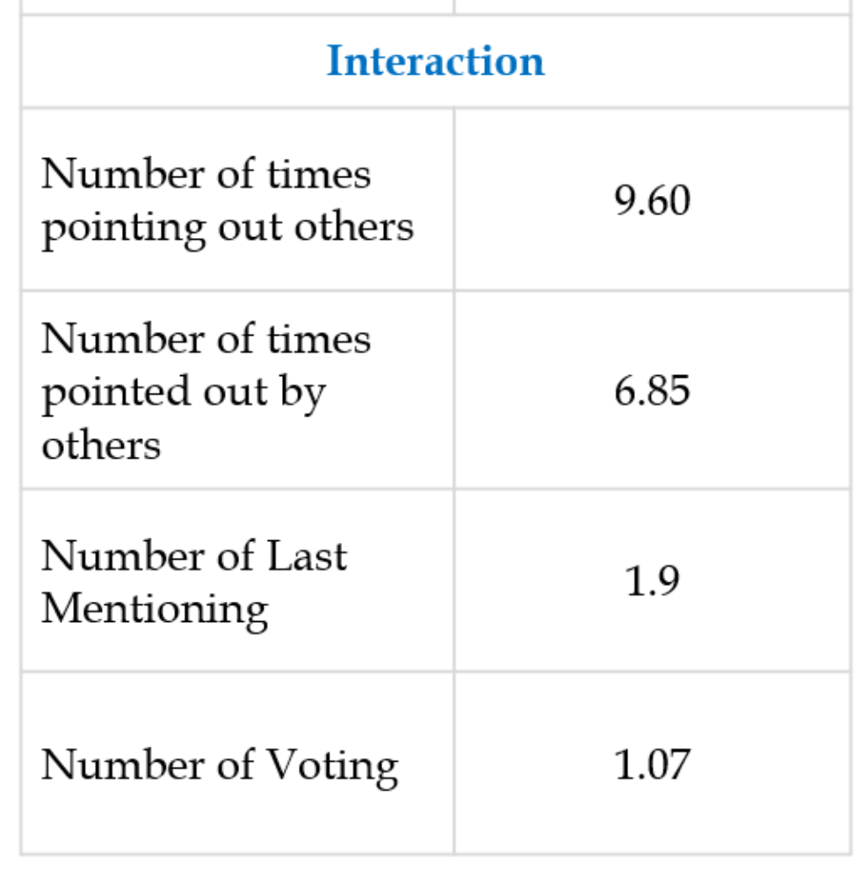
Experiment
Evaluation of Game Design (for All Players)
Rich game interactions and a progression in emotional assumptions by analyzing game log data
Well-motivated and engaged game design by analyzing post survey (GEQ, SUS, customized questions)
Notes:
The analysis of game log data shows rich game interactions and a progression in emotional assumptions. Additionally, the results of the post-survey show that the game was highly motivating and engaging for participants.

Slide 30
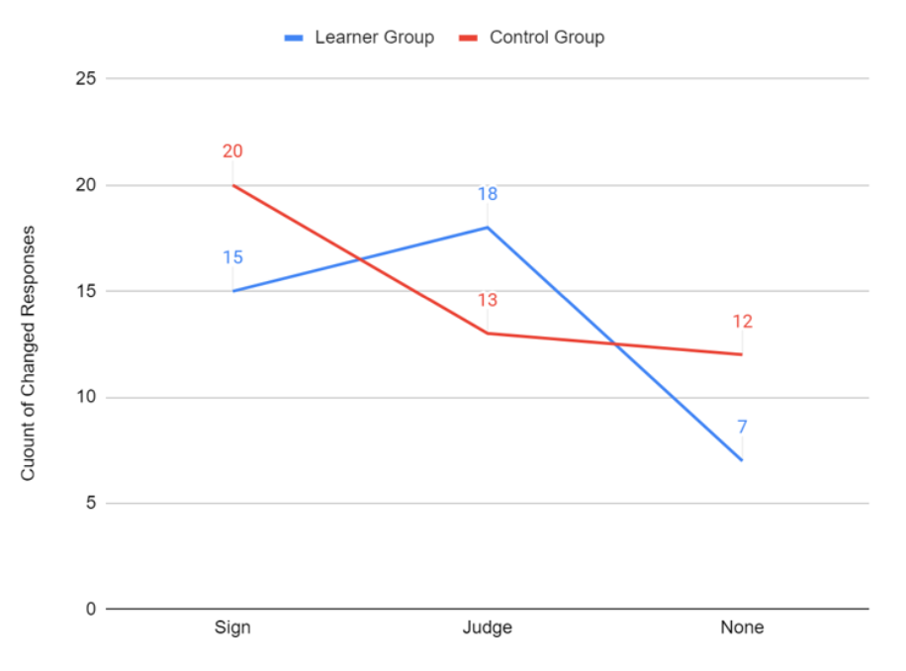
Experiment
Improvement on Judgment-based FER (Learner vs. Control)
The higher increase in inter-rater reliability of pre-and post-test responses in learner group (k=0.078) rather than control group (k=0.02)
A trend where the only learner group’s responses shifted towards judgment-based answers
Notes:
The comparison of inter-rater reliability and the trend of pre- and post-test responses indicates an improvement in judgment-based FER scores within the learner group.

Slide 31
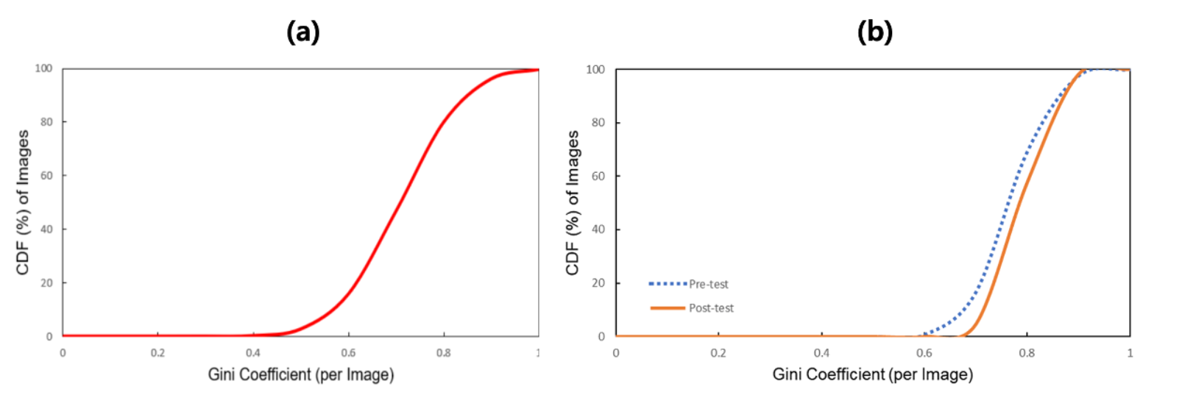
Experiment
Increase on Social Agreement of Collected Labels
The Gini coefficient of label distributions is highly skewed towards 1
A more skewed Gini coefficient of responses in the post-test compared to the pre-test
Notes:
The analysis of the Gini coefficient of collected labels and pre- and post-tests shows an increase in the social agreement of collected labels.

Slide 32
Discussion
Findings from the Study
Generalizability
The task could be answered in binary (e.g., yes or no) and does not require open-ended responses.
The task can be broken down into the smallest units of work.
The task is simple enough to allow users to make judgments within a few seconds without a second thought.
The task embraces subjective responses, but the expected responses should have high agreement rate.
Notes:
We have two main takeaways from the study. First of all, we suggest four task properties to generalize our approach to other domains.
We found that many common crowdsourcing or human perception problems have these properties, for example entity recognition, information retrieval, or object classification.
---------
particularly in domains where answers are ambiguous or subjective, such as entity recognition, information retrieval, or object classification. This is also true for problems in computer-based training of human perception, like judgments of others’ thoughts, empathy, personality, and intention from speech or text. We suggest that a range of domains beyond the one explored in this paper may also benefit from our approach.
---------------
1. Many classification tasks would belong to this class.
2. For example, multi-labeling tasks would not belong to this class because they cannot be reduced to binary labeling of ‘true’ or ‘false’.
3. For example, movie reviews or satisfaction ratings would not be suitable, because the responses may be dispersed.

Slide 33
Discussion
Findings from the Study
Guidelines for Game with a Purpose
Identification two important considerations in designing game interfaces to successfully engage and motivate participants
Benefits from consistent and attractive UI design
Usefulness of utilizing mainstream games
Notes:
Also, we identified two important considerations for designing game with a purpose: the benefits of a consistent and attractive UI design, and the usefulness of utilizing mainstream games. The participants comments that these elements were the most motivating.
----------------
“Write the best part of this game freely.”, majority of participants cited the UI design. P33 and P44 mentioned "The pixel-style graphics, fonts, and animation effects make the game more interesting for me.", and P16 referred “I felt that Find the Bot! could be released as a commercial game, not just a test.”
Although we did not incur a significant cost (in terms of human effort and financial resources) on UI design, since we only used open-source pixel graphics, icons, and fonts, Find the Bot! was able to elicit engaging game experi- ences from participants.
with the advance of generative models, researchers, especially those who are not expert designers, could benefit with minimal burden in their design endeavors.
---------------
To develop new and novel gamified interfaces, researchers typically aim to implement games from scratch, with entirely plot and rules. How- ever, contrary to expectations of being clichéd , participants cited the Mafia game storyline as one of the most motivating elements. Rather, P18 commented "It’s creative to connect facial emotion recognition, a completely unrelated topic, with the plot of the Mafia game." Based on these observations from our study, we noted that using mainstream game plot can benefit the design of gamified interfaces without hindering creativity. Additionally, its familiar rules not only reduce the time participants need to adapt to the system but also make it useful for redesigning to align with specific design goals.

Slide 34
Find the Bot!
Gamifying Facial Emotion Recognition for Both Human Training and Machine Learning Data Collection
Project page: https://github.com/diag-dgist/FindtheBot
Yeonsun Yang¹
Ahyeon Shin¹
Nayoung Kim¹
Huidam Woo¹
John Joon Young Chung²
Jean Y. Song¹
1
2
Midjourney
Notes:
So this is the end of the talk. If you want to find out more, please read the paper.
thank you for listening.

